Slide 1


Key Concepts of Islamic Financing and
Interest-Free
Home Ownership Program
By PERVEZ NASIM (Chairman)
Islamic Co-operative Housing Corporation Ltd.
Ansar Financial Group, Canada

Slide 2

Preamble
The very fundamental concept for us to understand and accept is the fact, as revealed by Allah, our creator and sustainer, in the Holy Quran:
“And It Is For Allah Whatever In The Heavens And
Whatever In The Earth.”
Presentation By PERVEZ NASIM
Islamic Co-operative Housing Corporation Ltd.
Ansar Financial Group, Canada

Slide 3

IN OTHER WORDS,
WE THE HUMAN BEINGS;
Do not really own anything in this World, Are just a trustee, will have to account for any and all breaches of this trust, abuse, misuse & injustices
Presentation By PERVEZ NASIM
Islamic Co-operative Housing Corporation Ltd.
Ansar Financial Group, Canada

Slide 4

WE THE HUMAN BEINGS
Come to this World with nothing, not even with a diaper;
We leave this World with nothing material;
only our good deeds and bad deeds go with us in our graves.
Presentation By PERVEZ NASIM
Islamic Co-operative Housing Corporation Ltd.
Ansar Financial Group, Canada

Slide 5

SHARIAH (ISLAMIC LAW)
REQUIRES FROM A MUSLIM THAT ONE MUST:
Have honesty and integrity;
Expect blessings and rewards from the Creator, in addition to monetary benefit;
Be truthful and not to deceive;
Be conscious of social and environmental cost/benefits; rather than just monetary fulfillment.
Presentation By PERVEZ NASIM
Islamic Co-operative Housing Corporation Ltd.
Ansar Financial Group, Canada

Slide 6
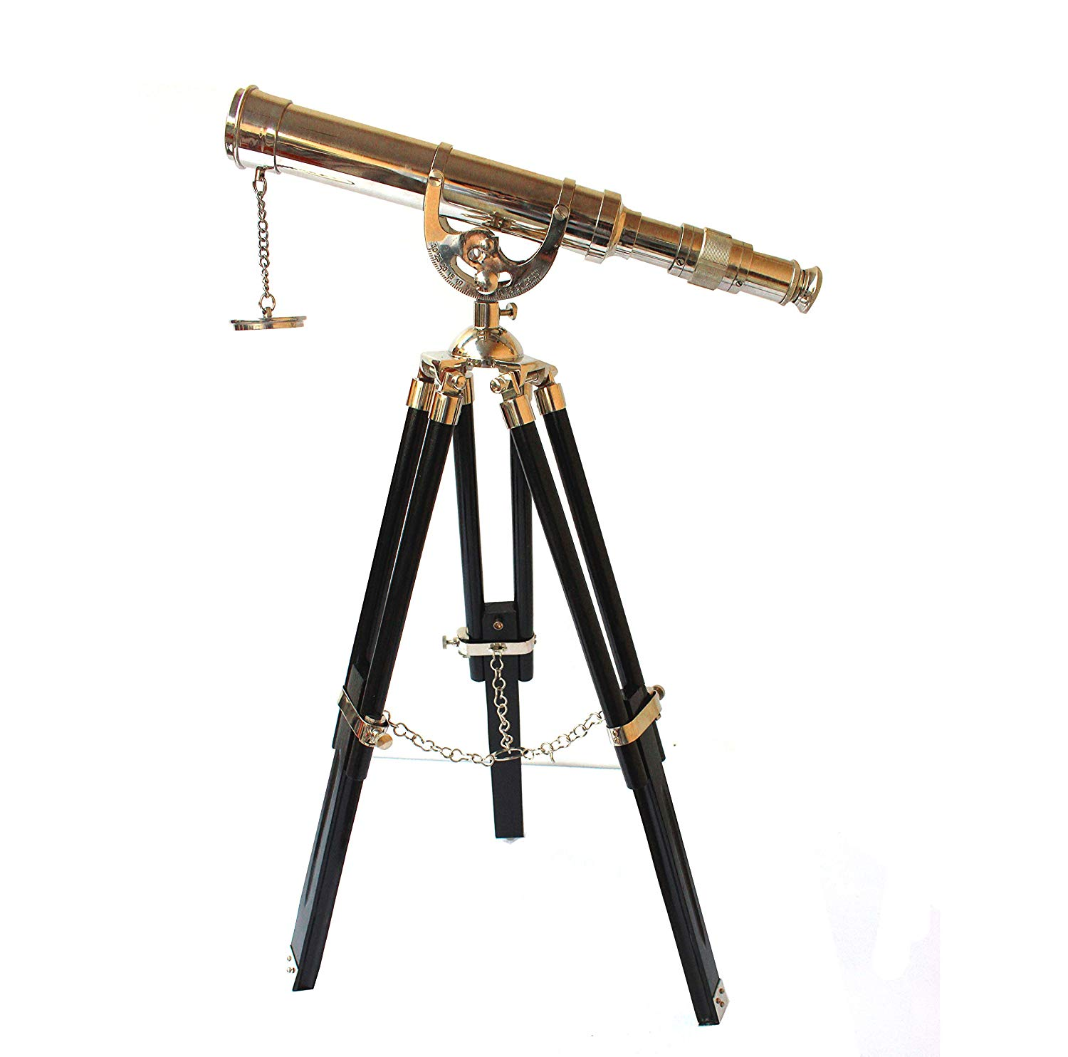
Misconceptions among Muslims particularly, and among some Non-Muslims, as Well!
Islamic banking and financing means; ‘conventional banking and financing’ delete the word “Interest”, add the word “Profit”!
Presentation By PERVEZ NASIM
Islamic Co-operative Housing Corporation Ltd.
Ansar Financial Group, Canada

Slide 7
Islamic Co-operative Housing Corporation Ltd.
Maximizing the profit is not the most important aspect of business
Charity and social responsibility are part and parcel with the bottom line
Presentation By PERVEZ NASIM
Islamic Co-operative Housing Corporation Ltd.
Ansar Financial Group, Canada

Slide 8


“AFFORRRDABLE AND INTEREST-FREE HOME OWNERSHIP”
ISLAMIC ALTERNATIVE
A PRACTICAL MODEL
By PERVEZ NASIM (Chairman)
Islamic Co-operative Housing Corporation Ltd.
Ansar Financial Group, Canada

Slide 9
Islamic Co-operative Housing Corporation Ltd.
North America’s 1st Islamic Financial Institution
An interest-free HOME OWNERSHIP and INVESTMENT Project established in 1980 in Canada
Presentation By PERVEZ NASIM
Islamic Co-operative Housing Corporation Ltd.
Ansar Financial Group, Canada

Slide 10
THE SHARIA MODEL ADOPTED BY THE CO-OP
Musharikah Mutanaqisah or Decreasing Partnership model was adopted;
For its simplicity and practical nature for the long-term transactions;
A Partnership between a Family and the Community (Co-op)
Presentation By PERVEZ NASIM
Islamic Co-operative Housing Corporation Ltd.
Ansar Financial Group, Canada

Slide 11
A PARTNERSHIP
Between the Islamic Financial Institution and
The Prospective Home Owner

Slide 12
Islamic Co-operative Housing Corporation Ltd.
THE CO-OP IS BEING MANAGED BY A BOARD OF SEVEN VOLUNTEERS WHO ARE ELECTED EVERY TWO YEARS
Presentation By PERVEZ NASIM
Islamic Co-operative Housing Corporation Ltd.
Ansar Financial Group, Canada

Slide 13
Our Objectives
To facilitate our committed members the opportunity to buy a house for their families without indulging in riba, and with as much security and flexibility as possible, within the taxation and legal framework of the country
and ………

Slide 14
…. to provide an Opportunity to Committed Muslims all over the World…
To mobilize and pool their savings and invest in the houses of fellow Muslims with no strings attached to a particular house;
To keep an individual’s funds as flexible as possible with the ability to sell/transfer his/her shares with a reasonable notice;
To maintain the security of the investment; and,
To share the capital gain or loss and the rental income of the
“Co-operative” in the form of dividends with all members.
Presentation By PERVEZ NASIM
Islamic Co-operative Housing Corporation Ltd.
Ansar Financial Group, Canada

Slide 15
TYPES OF MEMBRSHIP
Prospective Home Buyers;
Home Buyers under the interest-based mortgages;
Simple Investors;
Home Buyers under Co-op Scheme;
Institutional Investors;
Children/Grand Children
Presentation By PERVEZ NASIM
Islamic Co-operative Housing Corporation Ltd.
Ansar Financial Group, Canada

Slide 16
MEMBERS COMMITMENTS:
Pay $75 membership fee to join
Buy 6 shares of $100 each annually
Invest first and buy shares
20% of 1st $100,000 cost of house
25% of up to the next $100,000 cost
30% of over $200,000 cost of house
Presentation By PERVEZ NASIM
Islamic Co-operative Housing Corporation Ltd.
Ansar Financial Group, Canada

Slide 17
MEMBERS:
Pay proportionate rent
Increase their ownership when they can
    (every month or every second month or so on)
Rent decreases as ownership ratio increases (could be every month or so)
Share gain/loss 10% with the co-op
Legal ownership remains in the name of the housing co-op till 100% ownership shares are purchased by the member
Presentation By PERVEZ NASIM
Islamic Co-operative Housing Corporation Ltd.
Ansar Financial Group, Canada

Slide 18
MONTHLY RENT REVISION FORM
Membership #: R.E.P #: Revision # ____________
Effective , ________________ the total proportionate occupancy charges for the above housing unit will be $1,100.00 calculated as follows:
Shares previously held by the member $120,000.00
Additional shares purchased on _____________ $ 20,000.00
Total shares held by the member A = $140,000.00
Corporation's share B = $166,000.00
Cost of the Housing unit C = $306,000.00
Occupancy Charges (Rent) D = $ 2,000.00
Monthly Proportionate Rent: (B / C) x D $ 166,000 x 2,000 E = $ 1,085.00 $ 306,000
Add: Administration Fee: $ 15.00
TOTAL PROPORTIONATE RENT : $ 1,100.00
PREPARED BY:____________________ DATE:_______________________
Presentation By PERVEZ NASIM
Islamic Co-operative Housing Corporation Ltd.
Ansar Financial Group, Canada

Slide 19
SHARING OF GAIN OR LOSS
As a result of sale/transfer of the housing unit any gain or loss realized will be divided as follows:
If, at that time, the member has more than 50% shares,
10% to the Co-op and 90% to the member.
If the member has 50% or less shares, 20% to the Co-op and 80% to the member.
The capital gain or loss will be shared after making an adjustment for authorized improvements, expansions and certain legal expenses incurred by the member.
Presentation By PERVEZ NASIM
Islamic Co-operative Housing Corporation Ltd.
Ansar Financial Group, Canada

Slide 20
INCOME DISTRIBUTION:
Presentation By PERVEZ NASIM
Islamic Co-operative Housing Corporation Ltd.
Ansar Financial Group, Canada

Slide 21
Islamic Co-operative Housing Corporation Ltd.
Members are in drivers seat
Complete 100% ownership in 10-12 years
Conventional mortgages take 25-30 years
Presentation By PERVEZ NASIM
Islamic Co-operative Housing Corporation Ltd.
Ansar Financial Group, Canada

Slide 22

ANSAR FINANCIAL GROUP LAUNCHED A NEW CO-OPERATIVE IN 2003
ANSAR CO-OPERATIVE HOUSING CORPORATION LTD.
Ansar Co-operative operates under the same principles

Slide 23
COMBINED PRESENT STATUS
In thirty-seven years, purchased a little over eight hundred sixty (860) houses
Sold a little over $85 Million worth of Shares;
Gave Dividends between 3.6% and 10%.
For the year 2018 it is 3.6%;
Membership has grown to over 4,800 in North America and a good number from overseas as investors;
Presentation By PERVEZ NASIM
Islamic Co-operative Housing Corporation Ltd.
Ansar Financial Group, Canada

Slide 24
OTHER COMMUNITIES COPIED OUR MODEL
St. Louis, Missouri, USA
San Francesco, USA
Manchester, UK
Malaysia
Presentation By PERVEZ NASIM
Islamic Co-operative Housing Corporation Ltd.
Ansar Financial Group, Canada

Slide 25
Islamic Co-operative Housing Corporation Ltd.
Established Home & Auto Takaful for Co-op Members
in partnership with second largest Insurance Company in Canada
The Co-operators Insurance Group
Presentation By PERVEZ NASIM
Islamic Co-operative Housing Corporation Ltd.
Ansar Financial Group, Canada

Slide 26
OUR OTHER SERVICES AND PROJECTS
Business Financing & Joint Ventures
Car Ownership Plan
Interest-free Retirement Saving Plans
Equipment Leasing
Land Development
Residential & Industrial Construction and Development
Healthcare Facilities (Nursing Homes in Progress)
Presentation By PERVEZ NASIM
Islamic Co-operative Housing Corporation Ltd.
Ansar Financial Group, Canada

Slide 27

www.ansarhousing.com
E-mail achc@ansarhousing.com

Slide 28
Ansar Financial Group - AFG
(AG - Private + AFDC - Public)
Funds are invested in Ethically and Islamically permitted businesses/projects through Ansar Financial Group
Various Shariah concepts such as:
  MUSHARIKAH (partnership)
  MURABAHA (installment purchase)
  and IJARAH (leasing)
  are applied in the operation of all business transactions.
Presentation By PERVEZ NASIM
Islamic Co-operative Housing Corporation Ltd.
Ansar Financial Group, Canada

Slide 29
First Interest-Free Public Company in North America
Ansar Financial and
Development Corporation (AFDC)

Slide 30
First Interest-Free Public Company in North America listed on Exchange
HIGHLIGHTS OF AFDC IPO
Maximum Offering: $ 15,000,000
Sold 14,600,000 Common Shares in March 2010
$1.00 per Common Share
Current Portfolio over $15.5 Million
Shares are Tax-Deductible for Retirement, Education and Tax-Free Savings Plan
Presentation By PERVEZ NASIM
Islamic Co-operative Housing Corporation Ltd.
Ansar Financial Group, Canada

Slide 31
Core Principles of Business of this Corporation:
The Corporation (AFDC)
Is operating on Interest-free basis;
Is Prohibited from Borrowing Money on interest;
Has Sharia/Ethics Committee is mandated in the Corporation’s By-Laws
Presentation By PERVEZ NASIM
Islamic Co-operative Housing Corporation Ltd.
Ansar Financial Group, Canada

Slide 32
Leading Financial Development of the Community
1825 Markham Road, Suite 209
Toronto, ON M1B 4Z9
t: 1-416-646-1271
e: info@ansarfinancial.com
ansarfinancial.com

Slide 33
THANK YOU
1825 Markham Road, Suite 209
Toronto, ON M1B 4Z9
t: 1-416-646-1271
e: info@ansarfinancial.com
www.ansarfinancial.com

